Slide 1
TypeScript: Getting Started
INSTALLING TYPESCRIPT AND CONFIGURING A PROJECT

Slide 2

Overview
Course overview
MultiMath demo app Installing TypeScript Running the compiler
Configuring a project with tsconfig.json

Slide 3

Course Overview
Taking Advantage of Built-in Types
Writing Better Functions with TypeScript
Creating and Using Custom Types

Slide 4

Demo
Demo project overview

Slide 5
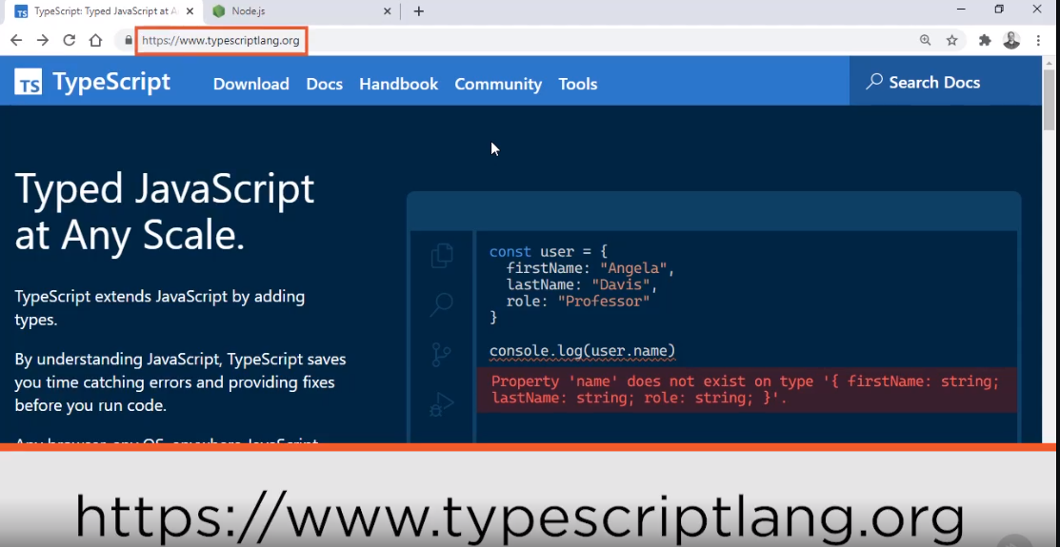

Slide 6
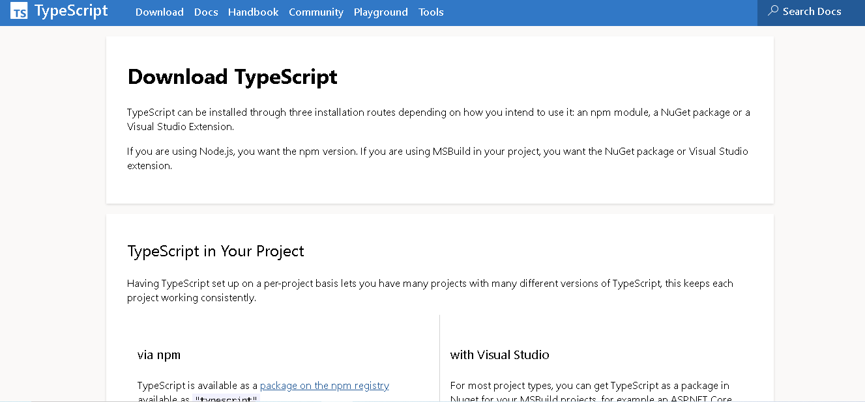

Slide 7
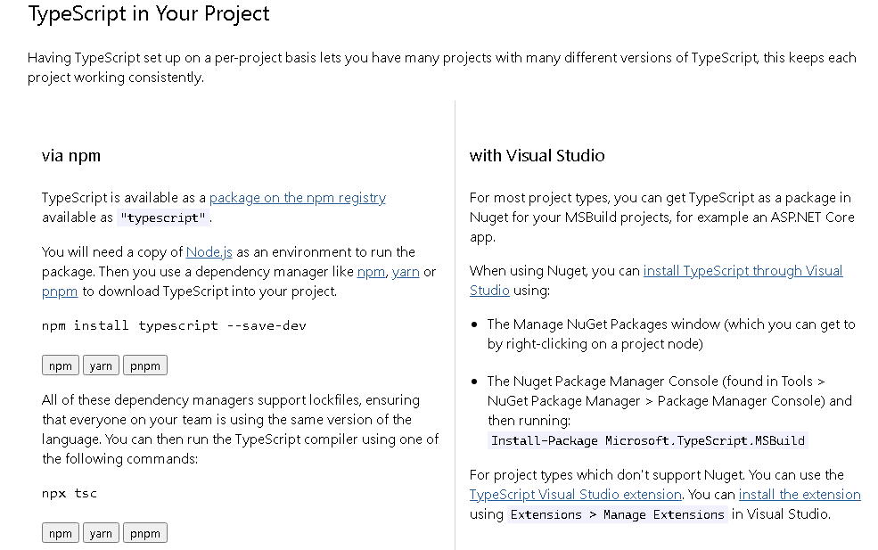

Slide 8
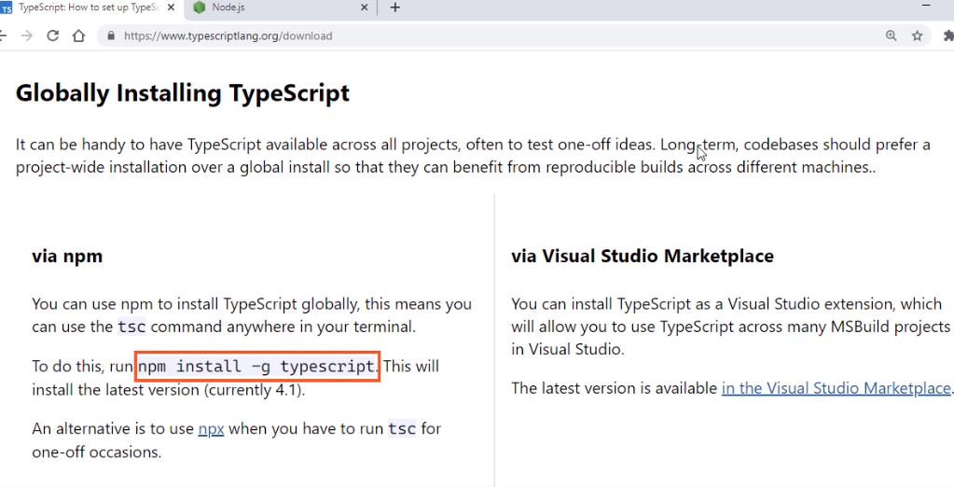

Slide 9
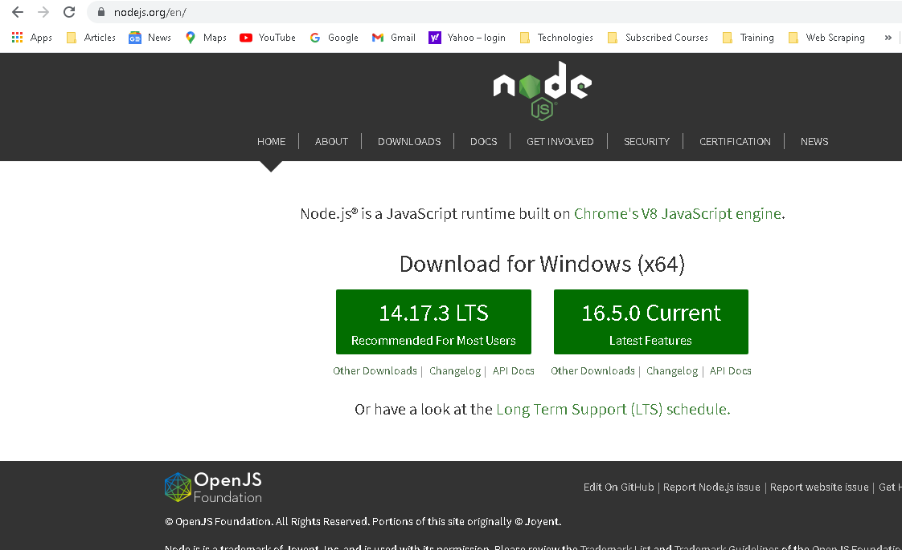

Slide 10
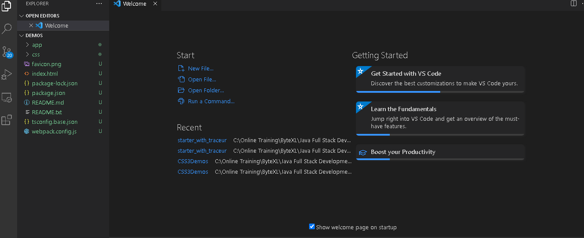

Slide 11
npm install

Slide 12
Demo
Installing TypeScript and running the compiler

Slide 13
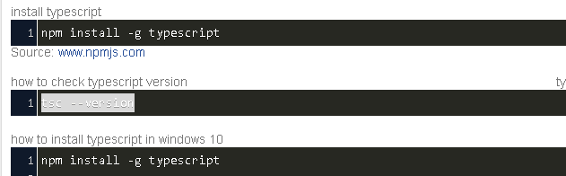
Check First if TypeScript is installed before running the install command

Slide 14

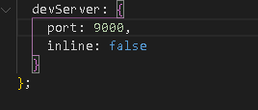
Change the Default Port in webpack

Slide 15




TypeScript Project Files
Simple JSON text file named tsconfig.json
Stores compiler options used with the project
Specifies files to be included or excluded in compilation
Supports configuration inheritance

Slide 16
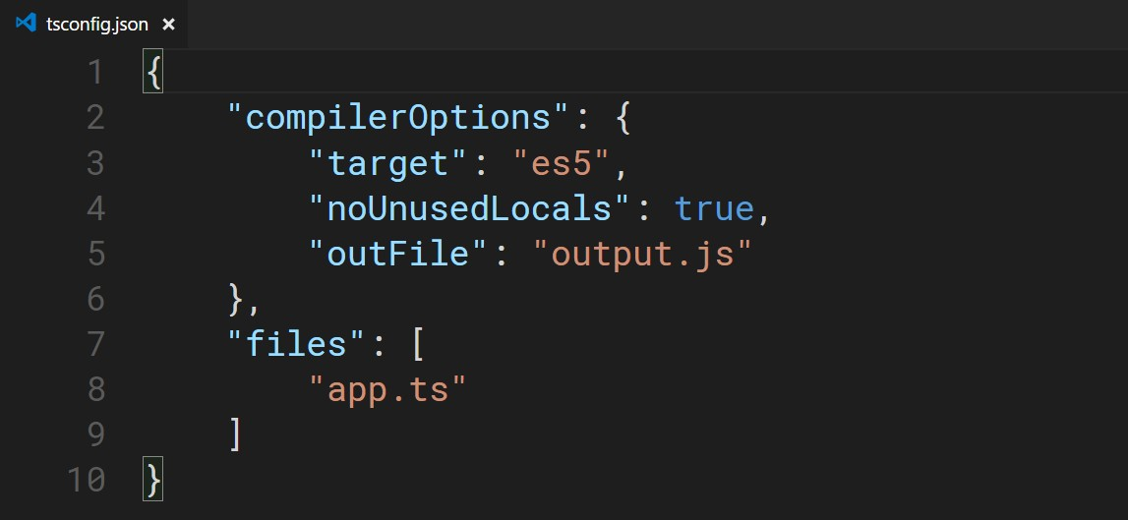
Adding Compiler Options to tsconfig.json

Slide 17
Adding Compiler Options to tsconfig.json

Slide 18
Adding Compiler Options to tsconfig.json

Slide 19
Adding Compiler Options to tsconfig.json

Slide 20
Adding Compiler Options to tsconfig.json

Slide 21
Adding Compiler Options to tsconfig.json

Slide 22
Adding Compiler Options to tsconfig.json

Slide 23
Demo
Configuring compiler options in tsconfig.json

Slide 24
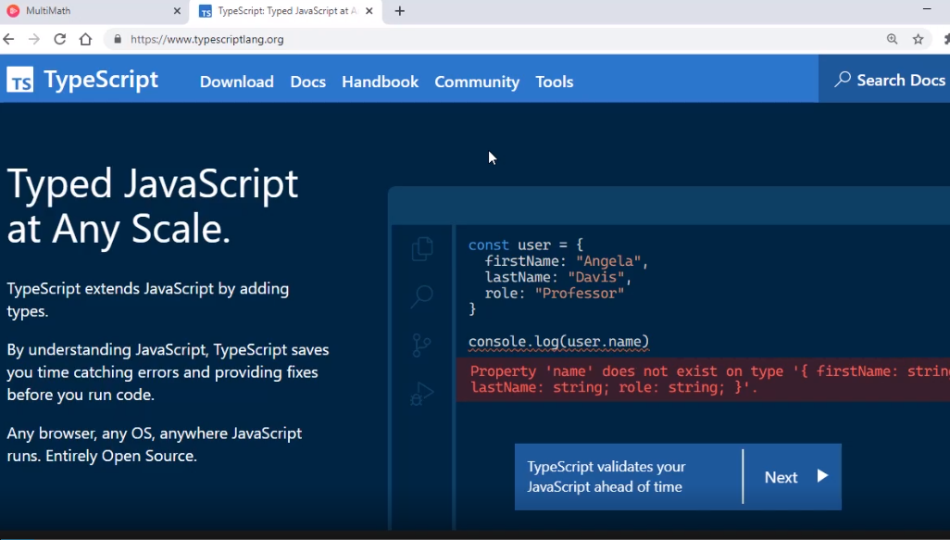

Slide 25
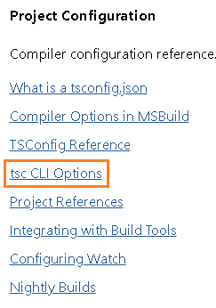
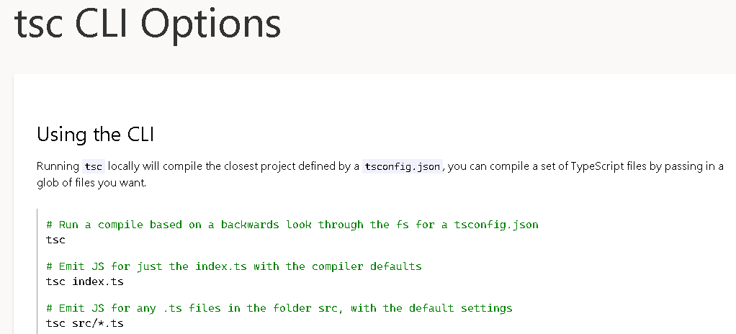


Slide 26
Demo
Configuration inheritance and glob support in tsconfig.json

Slide 27
Demo
Compiling with Webpack

Slide 28
TypeScript website
Installation with npm Compiler options
Project configuration with tsconfig.json Compiling with Webpack
Summary

Slide 29
Up Next:
Taking Advantage of Built-in Types

